Slide 1
Management 515
The Manager as
Planner and Strategist
© 2014 David E. Frick.
All rights reserved.

Slide 2
Mission, Vision, and Values
Mission Statement. A broad declaration of an organization’s purpose that identifies the organization’s products and customers and distinguishes the organization from its competitors
Vision Statement. A concise, powerful statement of the leaders desire of what the organization will look like in the future
Values Statement. A concise statement of the norms and ethics the organization considers important to achieve organizational goals
Notes:
Three essential tools used to convey the strategy are the mission statement, the vision statement, and the values statement.
The mission statement describes the overall purpose of the organization. This purpose is normally defined by the owners and can change over time as an organization grows or seeks new opportunities.
The mission statement should be sufficiently concise and non-complex as to allow every member of the organization to understand the purpose of the organizations existence. The wording must allow management and employees to infer order of priorities in how products and services are delivered.
A good mission statement clearly separates the mission of your organization from other organizations.
The vision statement is a vivid description of what the organization is or should look like as it effectively carries out its operations.
The vision statement should be short (I believe fewer than 10 words), incite that vivid image, and be repeatable, even if you have a gun pointed to your head.
The best vision statement that I have ever seen is from the Ritz Carlton Hotel, “Ladies and gentlemen, serving ladies and gentlemen.” Does this create an image in your mind? If a vision statement does not create an image in your mind, it is a bad statement.
The values statement represent the core priorities in the organization’s culture, including what drives members’ priorities and how they truly act in the organization, etc.
Values statements are important in strategic planning, because you must ensure that your planning and strategy development is consistent with the organizations values. For example, if a firm truly has the values of honesty and integrity, a strategy that requires actions that are ethically gray will likely fail.
In reality, a firm’s values reflect the morals of the people in the firm. Leaders or managers often make the mistake of stating what values they want the organization to have, not what truly exists. For example, a firm might claim that “customer service is a core value—the customer is the most important person in our world.” This sounds great, right? Good marketing words. Yet the strategy suggests laying off customer service representatives to save money, making the customer experience less enjoyable. In this case, the strategy is inconsistent with the values statement.

Slide 3
Mission and Goals
Defining the Business
Who are our customers?
What customer needs are being satisfied?
How are we satisfying customer needs?
Establishing Major Goals
Stretches the organization to higher levels of performance
Goals must be challenging but realistic with a definite period in which they are to be achieved
Notes:
The mission statement defines the goals of the firm.

Slide 4
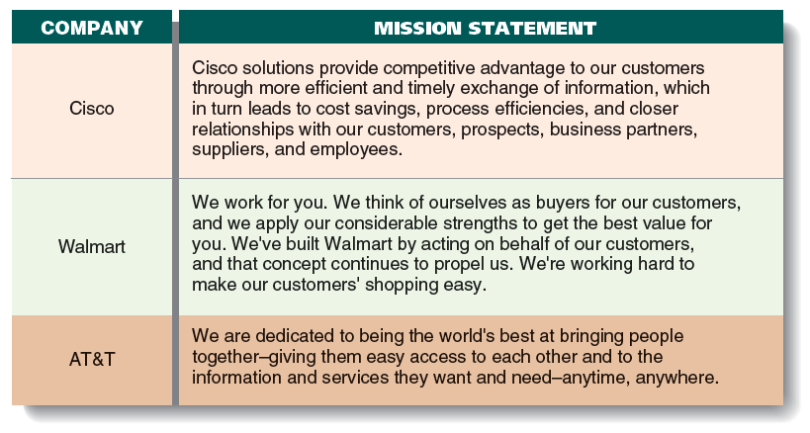
Mission Statement
Adapted from Contemporary Management, 8th. Jones and Garth
Notes:
Here are three real world examples of mission statements.
In my opinion, all of the are very poor. None of these mission statements speaks to earning money. I suspect earning money is very important to the owners (stockholders).
I am not suggesting that your mission statement should be as simple as, “We make money!” However, this flowery pabulum from Cisco, Wal-Mart, and AT&T does not tell me much. I know for certain that AT&T’s mission is to charge me as much as I will pay for lousy cell phone service.
Without a clear and honest mission statement, strategy development is more difficult and less effective.

Slide 5
Planning and Strategy
Planning. Identifying and selecting appropriate goals and courses of action for an organization
Where are we?
Where do we want to go?
Strategy. A cluster of decisions about what goals to pursue, what actions to take, and how to use resources to achieve goals:
How do we get there?
What rules do we follow?
The plan details the goals and the strategies managers will use to attain those goals
Notes:
Strategy is a high level plan to achieve one or more goals under conditions of uncertainty. Strategy is important because the resources available to achieve these goals are always limited.
Strategy generally involves setting goals, determining actions to achieve the goals, and mobilizing resources to execute the actions.
Another view is that a strategy describes how the ends (goals) will be achieved by the means (resources). The senior leadership of an organization is generally tasked with determining strategy.
Strategy can be predefined or can emerge over time as a pattern of activity the organization uses to adapt to its environment.

Slide 6
How Do We Get There?
Define the business
Evaluate results
Establish major goals
Define responsibilities
Analyze current situation
Allocate resources
Develop strategies
Notes:
Here is the basic approach to developing and implementing strategies.
This is the generic “V” model. As you travel back up the “V” on the right, you must check back with the associated action to ensure all elements have been addressed.
For example, step two is to “establish major goals.” As we continue to the “define responsibilities” step, you need to check back to ensure each goal has an associated person assigned to the responsibility.

Slide 7
The Nature of Planning
To perform the planning task, senior managers:
Establish and discover where an organization is at the present time
Determine its desired future state
Decide how to move it forward to reach that future state
Use planning as a way of getting managers at all levels to participate in decision making about the goals and strategies
Coordinate the KSAs of managers of different functions and divisions
Use planning as a device for controlling managers
“Plans are nothing; planning is everything.”
--Dwight D. Eisenhower
Notes:
Planning is the process of thinking about and organizing the activities required to achieve a desired goal. It involves the creation and maintenance of a plan.
Planning is a structured process; however the specific process can vary from discipline to discipline. For example, the military planning process leading to the development of a battle plan is different from business planning leading to a business strategy.
An important, albeit often ignored aspect of planning, is the relationship it holds to forecasting. Forecasting can be described as predicting what the future will look like. Plans that do not adequately challenge assumptions created from forecasting will invariably prove ineffective. This uncertainty is usually addressed in what is commonly called “risk management” or “risk planning.”
The quote at the bottom from (then) General Eisenhower expresses his believe that the output of the planning process (the physical plan) is not as important as the though processes used in planning. Planning should be continuously addressed.

Slide 8
Principles
Unity. Only one central, guiding plan to put into operation should exist at any one time
Continuity. Planning is an ongoing process in which managers build and refine previous plans and continually modify plans at all levels
Notes:
Principles of planning and strategy above.
Firms should ensure that plans are consistent. Only one master plan exists for a specific topic and any subordinate plans are consistent with the master plan. For example, corporate headquarters develops and publishes a master strategy. The plans and strategies developed by subordinate companies must be consistent with the corporate plan and not case the subordinate company to do things that are harmful to the corporation.
Contingency or continuity planning combines forecasting with preparation of scenarios and how to react to them. A business might develop plans to react to natural disasters or political events. The conditions that trigger the execution of a contingency plan may not be exactly predicted, but the forethought used in the scenario development can help the firm react more quickly and save time, money, and sometimes lives.
A subtle difference between contingency and continuity planning exists. Contingency planning is “how do we change what we normally do to react to external events.” Continuity plans address “doing things in reaction to external events to allow us to continue to do what we normally do.”

Slide 9
Levels of Planning
CEO
Corporate
Corporate Office
East Coast
Division/Company
West Coast
Manufacturing
Finance
Shipping
Manufacturing
Finance
Shipping
Functional
Notes:
Each element and level in a firm should have strategies and plans to implement those strategies.
As stated previously, each level must be consistent with the higher level.

Slide 10
Time Horizons
Time Horizon. Period of time over which they are intended to apply or endure
Long-term plans are usually 5 years or more
Intermediate-term plans are 1 to 5 years
Short-term plans are less than 1 year
Corporate and business-level goals and strategies require longer term plans
Functional plans focus on shorter terms
Most organizations have a rolling planning cycle to amend plans constantly
Notes:
Time horizons vary by industry, purpose, and culture. For example, Asian firms tend to have a longer view of the world, while U.S. firms tend to focus on the short term.

Slide 11
Types of Plans
Standing Plans. Used in programmed decision situations
Policies. General guidelines to action
Rules. Formal written specific guides to action
Standard (or Standing) operating procedures (SOP). Specify an exact series of actions to follow for recurring issues
Single-Use Plans. Developed to handle non-programmed decision-making in one-of-a-kind situations
Program Plans. Integrated plans for achieving certain goals or series of projects
Project Plans. Specific action plans to complete specific projects
Notes:
Some definitions.

Slide 12
Contingency
The generation of multiple forecasts of future conditions or events and the creation of plans to effectively respond to those conditions or event
Disaster recovery plans
Risk mitigation plans
Contingency planning seeks predict the future, but the future is unpredictable
By generating multiple possible “futures,” a firm can see how its plans might work in each
Scenario planning can be used as a learning tool to improve strategic planning
Notes:
A little more on contingency planning.
Contingency plans are often devised by governments or businesses.
For example, suppose many employees of a company are traveling together on an aircraft which crashes, killing all aboard. The company could be severely strained or even ruined by such a loss.
Accordingly, the wise firm has procedures to react to such a disaster. The plan may also include standing policies to mitigate a disaster's potential impact, such as requiring employees to travel separately or limiting the number of employees on any one aircraft.
During times of crisis, contingency plans are often developed to explore and prepare for any eventuality. During the Cold War, the United States developed contingency plans to protect citizens from nuclear attack

Slide 13
Strategic Leadership
The ability of the top managers to convey a compelling vision of what they want the organization to achieve to their subordinates
The purest form of leadership. It is central to change.
Businesses that die do so for one of two reasons:
They continue to do the same thing and get left behind
They only do the new thing and never milk the cash cow
It takes a balance
Notes:
The obligation of stating the Mission-Vision-Values statements fall to the senior leaders or owners. This is part of strategic leadership.
To paraphrase Lewis Carroll, “If you do not know where you are going, any plan will get you there.”

Slide 14
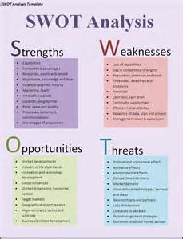
SWOT Analysis
A planning exercise in which managers identify organizational:
Strengths (S)
Weaknesses (W)
Opportunities (O)
Threats (T)
Notes:
A common, and I would argue essential part of planning is the SWOT analysis.
Look at https://en.wikipedia.org/wiki/SWOT_analysis and http://managementstudyguide.com/swot-analysis.htm for additional information.
Yes, do it. You will need the knowledge to answer exam questions.

Slide 15
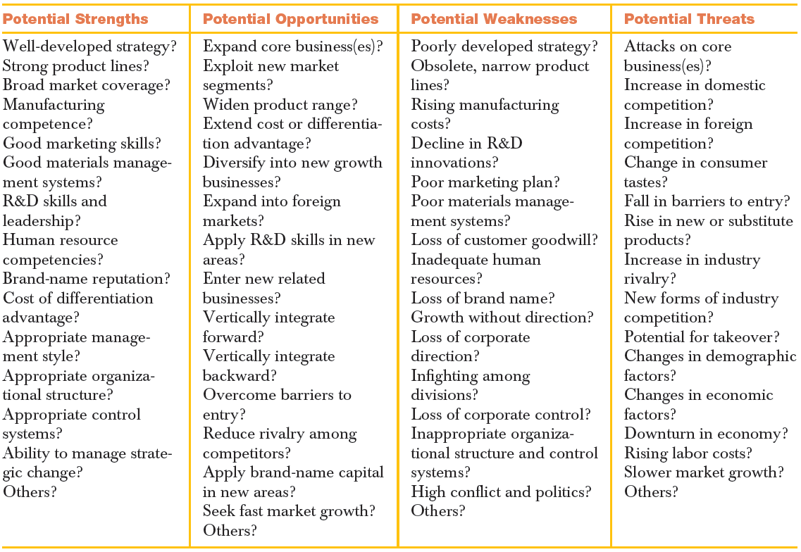
What questions do we ask?
Notes:
This is not a complete list, but representative of the questions planners must ask to be effective at the process.

Slide 16
Porter’s Five Forces Model
Bargaining Power of Suppliers
Threat of new entrants
Intensity of Competition
Threat of Substitutes
Bargaining Power of Buyers
Notes:
Porter’s Five Forces Model is another useful model for planning. It’s principle purpose is to evaluate the attractiveness of entering an industry, but it is also useful for developing a strategy that changes a firm’s focus, missions, or purpose. It is not perfect, but it helps you to apply a structure to your process.
View: https://www.youtube.com/watch?v=uvwjip3CTMA
Yes, you have to watch the video. You will have questions of your exams.

